Slide 1

An Automated COVID-19 SOPs Monitoring And Management System
GSN: FALL 21-18
Presented by:
Maaheen Yasin (L18-1267)
Inbisat Mudassar Dar (L18-1283)
Ahmad Tameem Kamal (L18-1358)
Advisor: Mr. Hamza Yousuf
Client: Saleem Steel Industries
Evaluation Committee:
Ms. Shazia Haque
Dr. Omer Saleem

Slide 2

SLO 3.1: Design Requirements
SLO 3.2: Feasibility
SLO 3.3: Conceptualization
SLO 3.4: Preliminary Design
SLO 5.1: Identification (Why YOLO?)
SLO 4.3: Conduct Experiment: Block Diagram For Social Distancing
SLO 4.3: Conduct Experiment: Social Distancing Detection On Video
SLO 4.3: Conduct Experiment: Social Distancing Detection In Real-time
SLO 7.1 & 7.2: Social And Environmental Impact
SLO 11.1: Integration And Scope Management (Gantt Chart)
SLO 12.1: Recognize & Search
CONTENTS

Slide 3

SLO 3.1: DESIGN REQUIREMENTS
REQUIREMENTS:
Client wants a standing system for detection and sensing purpose
Various software algorithms to be used
Vision, temperature and Oxygen detection sensors required
Compute FPS and increase accuracy using software
CONSTRAINTS:
Non water-resistant
Not to be placed under high temperatures/direct sunlight
Sensors are fragile

Slide 4
SLO 3.2: FEASIBILITY
Resource planning
Project divided into modules
Modules allotted to members
Weekly progress chart maintained
Work breakdown structure and Gantt chart developed
Finances
Decision made on budget allocation
Budget divided against each module after market research
Estimated cost table designed
Amount kept as backup for any replacement/urgent use

Slide 5
SLO 3.3: CONCEPTUALIZATION
Distinct Solutions:
Face mask detection done using NVIDIA JETSON Tx1 and YOLO V4 algorithm
A walkthrough gate designed with temperature sensing and mask detection (through image capturing)
Risk Assessment:
Expensive hardware exceeds estimated budget and reduces market value of project
No real-time detection can lead to more often chances of passing through unchecked
Tradeoff Analysis:
These projects give higher accuracy in results but cost would be compromised
Image capturing does provide authentic proofs for higher authorities but wastes a lot of time

Slide 6
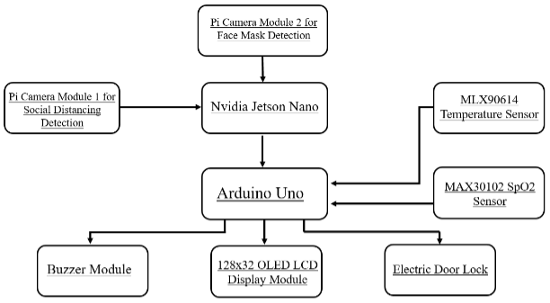
SLO 3.4: PRELIMINARY DESIGN
Hardware Layout:
STEP1:
32-bit computer interfaced with
Vision sensors
STEP2:
8 bit computer interfaced with
Temperature and SpO2 detection
sensor, display module, door lock
module and alarm generation
Module
STEP3:
32-bit computer interfaced with
8-bit computer

Slide 7
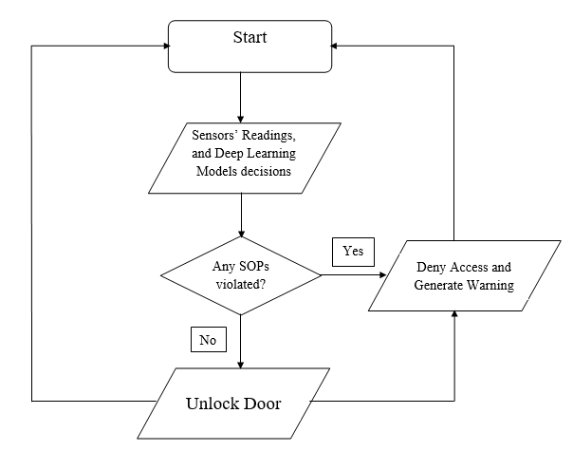
SLO 3.4: PRELIMINARY DESIGN (CONT.)
Software Layout:
STEP1:
System is started and then sensors fetch data, which
are pass through several ML algorithms
STEP2:
Decision is made on the basis of these algorithms and
compared with threshold values
STEP3:
If SOPs violated, initiate signal to alarm and lock door.
If SOPs followed, initiate signal to open door lock

Slide 8
SLO 5.1: Identification (Why YOLO?)
Challenges for Real-Time Object Detection?
Variable Number of Objects in a Frame
Multiple Spatial Scales and Aspect Ratios
Modeling
Limited Data
Speed for Real-Time detection
Other Deep Learning Models that could be used are:
Fast R-CNN
SSD
YOLO tackles all of these challenges successfully.

Slide 9
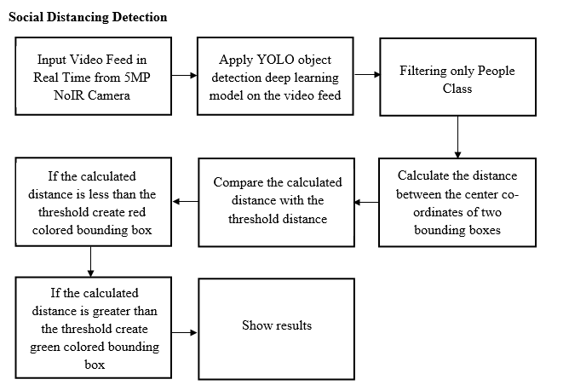
SLO 4.3: Conduct Experiment: Block Diagram for Social Distancing

Slide 10
SLO 7.1 & 7.2
SLO 7.1: Social Impact of the Project
It will instigate discipline among the community
Spread awareness that COVID is not gone and we need to follow the SOPs
Slows down the rapid spread of COVID
A great helping hand for higher health authorities
SLO 7.2: Environmental Impact of the Project
This project does not emit any harmful rays, fumes, or sounds
Low power consumption project

Slide 11
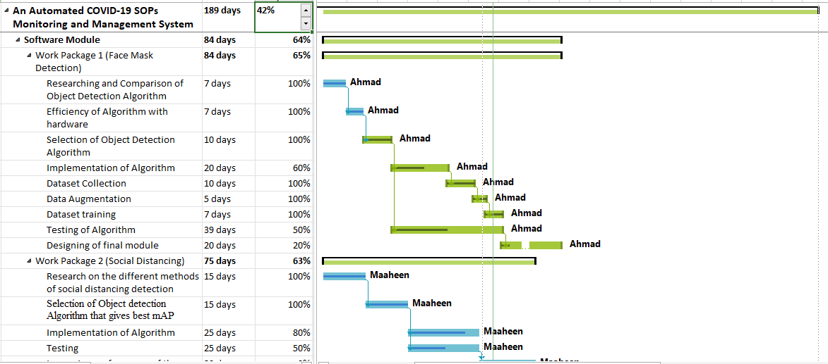
SLO 11.1: Integration and Scope Management (Gantt Chart)

Slide 12
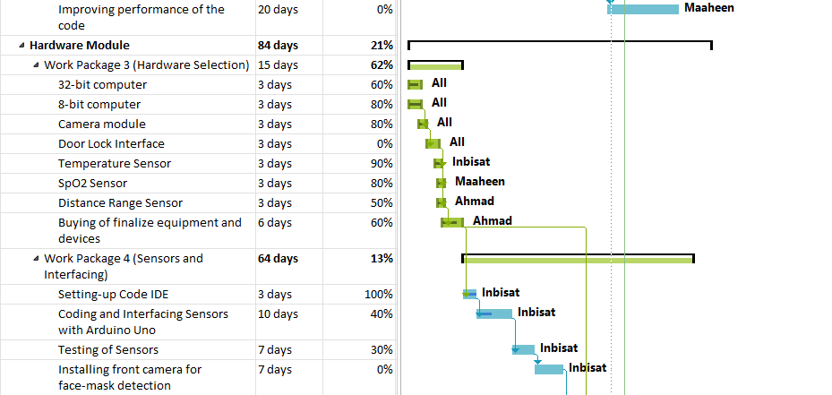
SLO 11.1: Gantt Chart

Slide 13
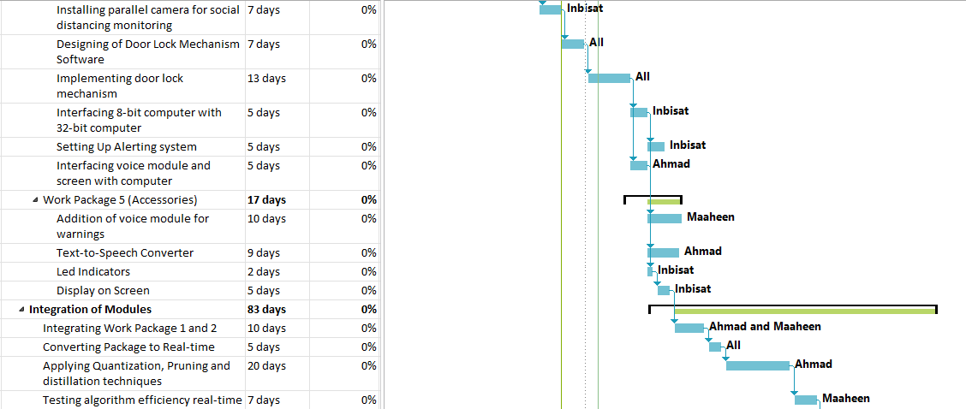
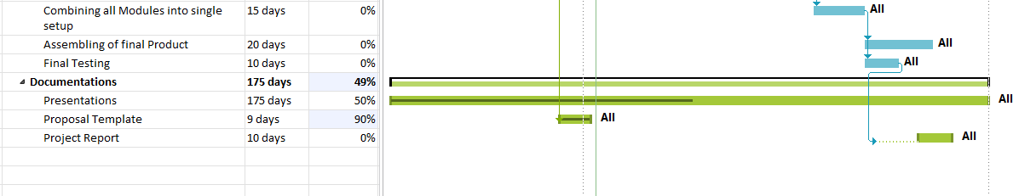
SLO 11.1: Gantt Chart

Slide 14
SLO 12.1: Recognize & Search
What was the need of research?
We were not proficient in Artificial Intelligence and Deep Learning
No project is done without research
What was researched?
What is Deep Learning and its basic concepts?
How does Deep Learning models work?
Different Deep Learning Algorithms that were required for Face Mask Detection and Social Distancing?
Selection of Algorithm and its implementation
Detailed Hardware research using the required components datasheets
What resources were used?
Took courses from Udemy and edX
IEEE Research Papers
GitHub
Other websites available on Google

Slide 15
